Slide 1
Speed (km/hour)
1.7×10⁻⁸ Hair growth.
3.6–5.4 Average walking speed.
1,193.4 Speed of sound in air at sea level and 0°C.
1,670 Speed of Earth's rotation at the equator.
2,170.8 Speed of the Concorde airliner.
107,280 Speed of the Earth in orbit around the Sun.

Slide 2
Speed
252,792 Speed of the Helios 2 solar probe—Fastest man-made object.
700,000 Orbital speed of the solar system in the Milky Way galaxy.
1,990,000 Speed of the Milky Way, relative to the cosmic microwave background.
100,000,000 Typical speed of an electron in a cathode ray tube.

Slide 3
Speed
720,000,000 Speed of a signal in a cable.
1,079,252,848.8 Speed of light (or electromagnetic radiation) in vacuum
Anything faster than light is not yet known, but time becomes irrelevant in that domain.

Slide 4

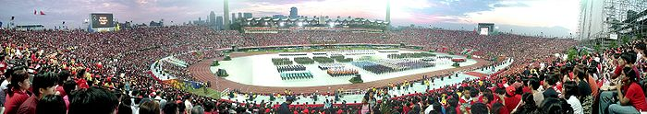
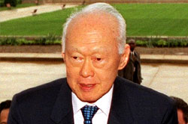
Cast out of the Malaysian Federation
on 9 August, 1965.
Was not expected to survive, politically or economically. How could one crowded city, without adequate material resources, or even enough water, survive in any form?
And yet Singapore prospered.
Its per capita income grew from US$600 in 1965 to $35,650 in 2007, with a purchasing power per head $5,000 more than Great Britain ($38,340 compared to $43,430). It was more affluent than its ex-colonial master.
Land area: 624 sq km
Total area: 692.7 sq km
Population: 5M
Second most densely populated country
Lee Kuan Yew, a lawyer
with a Double First degree
from Cambridge

