Slide 1

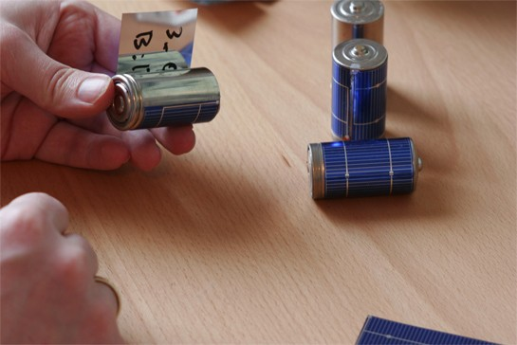
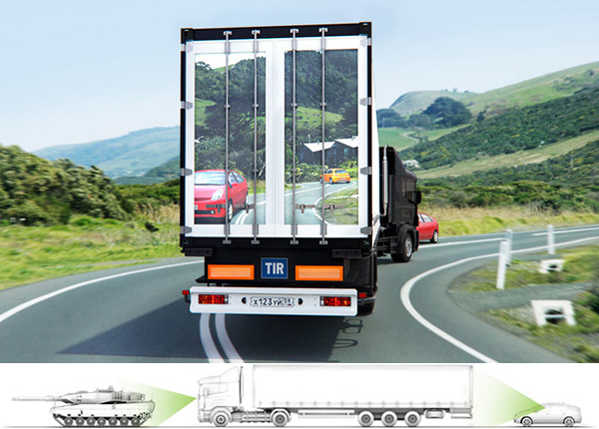
I n n o v a t i o n
http://jyoti.tandukar.net/innovation

Slide 2
Invention
A technical solution to a technical problem. an innovative idea, a working model or prototype
Innovation
The translation of the invention into a marketable product or process.
Source: World Intellectual Property Organization

Slide 3
Why Innovation
To improve manufacturing processes in order to save costs and improve productivity
To introduce new products that meet customer needs
To remain ahead of the competition and/or expand market share
To ensure that technology is developed to meet actual and emerging needs of the business and its clients
To prevent technological dependence on other companies’ technology
Source: World Intellectual Property Organization

Slide 4


Social
Commercial
Academic
Nepal Wireless Project
Hydrogen Car
Big
Positive
Change
Google
iPhone
Internet
Wikipedia

Slide 5
Thinking
differently
and
dynamically
is essential …
since this information age is different than industrial age …
and more importantly, technology is changing so rapidly.

Slide 6
You will benefit from
learning inspiring technology success stories, and technologies for future
developing the skills of thinking, assessing and refining technological solutions
knowing how to plan, protect and deploy new technology as commercially viable solution
developing personal skills in communicating, presenting and report writing
practicing the habit of working in a heterogeneous team of various strengths

Slide 7
but this does
not introduce
any methodology
or problem
solving process
TRIZ
PDCA
Six
Thinking
Hats

Slide 8
Workshop Sessions
Assessment of thinking habit and technology updates + Eye opening and inspiring lectures + Extensive participatory debates and discussions + Heavy internet based research + Rigorous presentations of ideas and plans + Rapid application development and prototyping + Personalized and selective industry visits if required + Proposal and report writing

Slide 9
Evaluation
Students will be loaded with group and individual assignments that needs to be presented and/or submitted, that includes review of reading materials, submission of their own ideas, writing patent application, business plan and even a thesis proposal.

Slide 10
Continuous Assessment (80%)
Final written exam (20%)
Team work
Attendance
Constructive criticism
Submission
Presentation
Punctuality
Participation

Slide 11

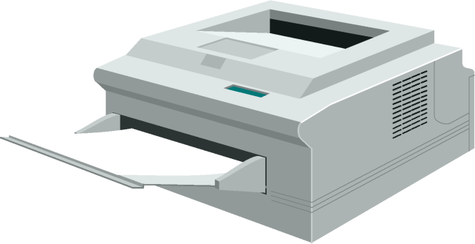


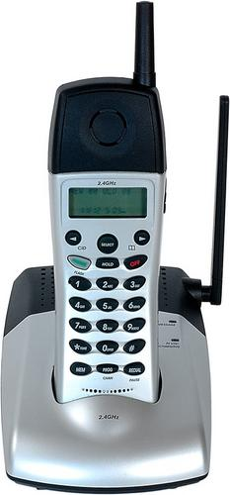

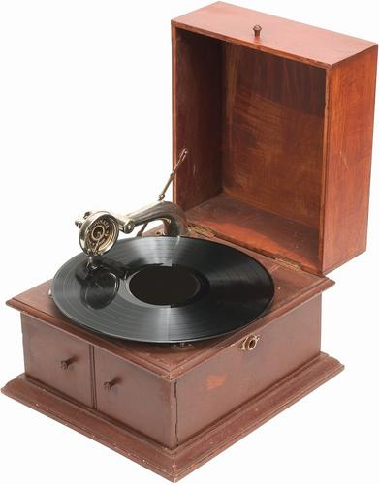


Infrastructure
Electricity = Technology
Notes:
The invention of electricity gave birth to so many appliances, that we hardly consider electricity as technology any more. It is an infrastructure now.

Slide 12

















Internet = Infrastructure
Notes:
Internet is becoming another infrastructure for our digitally enhanced life.

Slide 13
TELEGRAPH
TELEPHONE
LETTER
ISD
FAX
COURIER
MOBILE
Cost barrier
But no alternative yet
EMAIL
SMS
Limited reach
Emerging issues
INTERNET PHONE
Cost barrier alternative
compromises in quality
HAND HELD . WIRELESS . INTERNET
The immediate future of communication technology
Connect anytime anywhere at lowest possible cost through
Email, sms, mms, IM, VoIP and of course phone.
Plus MORE: GPS applications, G-sensor applications, Media player

Slide 14


TV
Audio Recorder
Web Browser
Video Player
GPS
Music Player
Clock
Calculator
Email Client
Gaming
Back up Storage
Camera
PDA
Phone
Torch
FM
Skype Phone
Wallet
Photo Album
Online Services
SMS/MMS
Document Viewer
Video Recorder
Level Meter

Slide 15
You knew. But, are you aware?
Who invented these life changing technologies? People like you!!
Until ____??, there was no schedule for the ship carrying containers of goods to arrive at the port.
Today, you can track your parcel from the time it leaves the source until it arrives at your door step.
Tomorrow, your devices are going to be intelligent enough to tell the supplier when to dispatch what, without you being involved.

Slide 16
Business
A Risk
Innovation
Eliminates risk
Product
Innovation
Process
Innovation
Presentation
Innovation
Xerox’s Photocopier
Sony’s walkman
Hotmail’s webmail
Dell's direct marketing,
Google search engine
US's economic supremacy
Nintendo Wii
Apple's iPhone
Barack Obama's presidential campaign for change

Slide 17
Innovation is not enough
Sometimes, product innovation alone is not sufficient for business success. We have seen many examples of the innovative product being quickly copied by industry giants, and making their copied product successful instead through their influence, capacity and market reach, eventually killing the original. Microsoft is notoriously known for this kind of strategy.

Slide 18
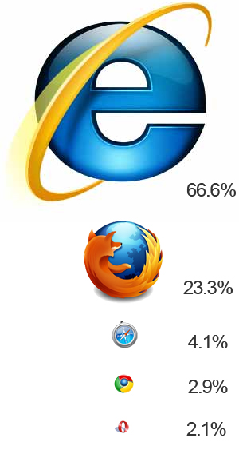

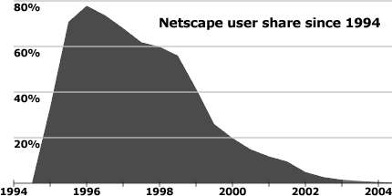
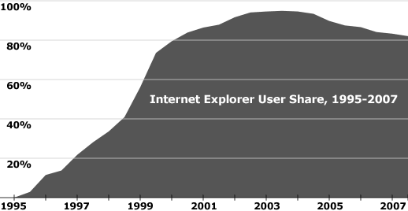

1 Sep 2009

Slide 19
We create a boundary made of our knowledge and experience.
(we are taught to do so)
Impossible
No way
Not possible

Slide 20
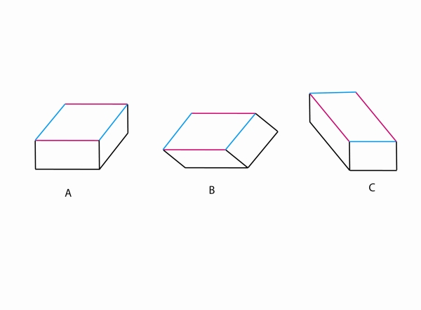
Impossible = I’m possible

Slide 21
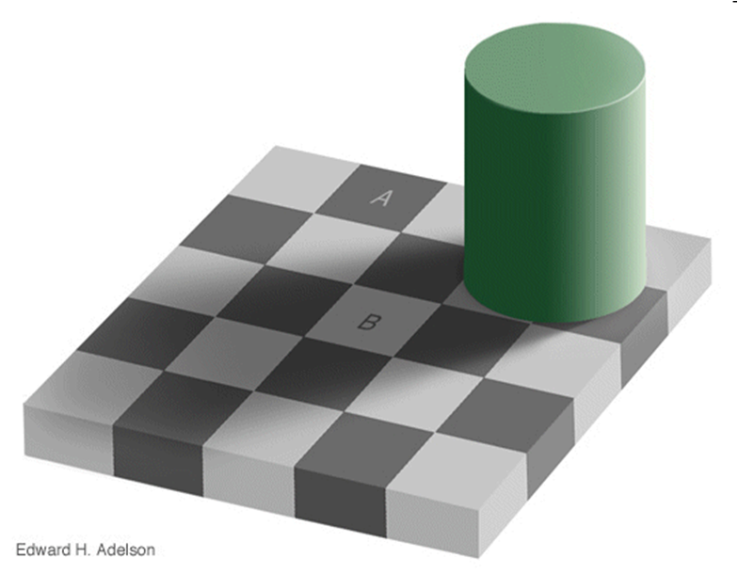

If someone comes to you excited and tells that A and B are same color backgrounds, what will be your reaction?
It is NOT necessary that we see the right thing all the time.
Notes:
It is NOT necessary that we see the right thing all the time.

Slide 22


Our perception could be badly affected by our surroundings.
Notes:
Our perception could be badly affected by our surroundings.

Slide 23
T . H . I . N . K
IDEAS . IMPROVEMENTS . TRANSFORMATIONS
Exercise . Materials . Discussions
Investigate . Invent . Refine
Plan . Protect . Deploy

Slide 24

T
Technology
H
Hindrance
I
Imagination
N
K
Nature
Knowledge

Slide 25
Technology Lesson
The Sixth Sense Video
Connect THINK to this video
Read Hindu Mythology and Natural Ideas
Investigate for more of such ideas
Internet and Education
Turning Technology into Fortune

Slide 26
Moving Ahead
Read this article on Kurzweil in Fortune
See this Singularity University presentation
Watch TED talks by Kurzweil (2005, 2009)
Watch TED talks by Diamandis (2005, 2008)
Watch these “Did you know” series of videos
Watch this “A vision of student today” video
Submit your handwritten write up on why have to chosen to do MSc. (TIM) within 4 days

