Slide 1

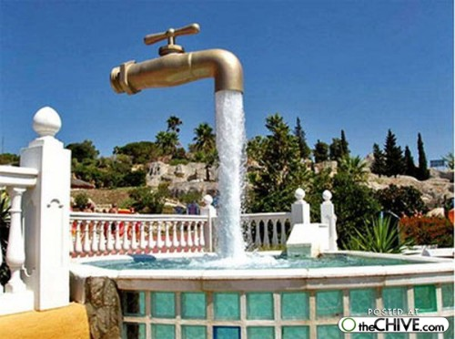
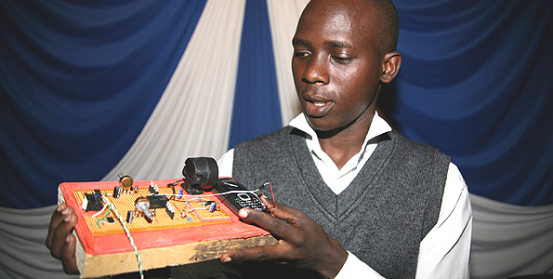
I n n o v a t i o n
http://jyoti.tandukar.net/innovation
3

Slide 2
We create a boundary made of our knowledge and experience.
(we are taught to do so)
Impossible
No way
Not possible

Slide 3
Thinking out of the box
Connect the nine points together with at most four straight lines without lifting your pen or pencil from the paper.

Slide 4
Tom Wujec, Mental Fitness
If you break more assumption, you will find more solutions:
Assumption: The lines must pass through the center of the dots.
If you draw lines that just touch the dots, you can solve the puzzle in three strokes.

Slide 5
Assumption: The lines must be thin.
Connect the dots with one fat line and you have solved the problem.
Assumption: You may not crease the paper.
Fold the paper in such a way that the dots line up.
In this case, you only need one stroke.

Slide 6
Assumption:
The paper must be flat.
Roll the paper into a tube and it’s possible
to connect the dots with a spiral.
When unrolled, the spiral becomes a straight line.

Slide 7
Move one and only one of the four matches to make a square. You may not bend or break any of the matches.

Slide 8
In how many ways can you divide a square into four identical parts?
Aim for ten different ways.

Slide 9
O
O
The half of 8
= 4
VIII

Slide 10
ATM PIN
ATM Panic/Safety PIN
Alert police, activates high res high frame rate camera
On dispensed money, print “Stolen, Call Police” in UV ink.
One extra PIN to remember?
Just use your PIN in reverse.
Police need time to respond,
so why not also slow down the dispensing process?
ATM Iris
Finger Print ATM
http://www.halfbakery.com/idea/Panic_20PIN#1234420796

Slide 11
Mary Anderson patented her invention of the mechanical windshield wiper in 1905, and it became standard equipment by 1913.
Wiper
Hawaiian dentist Dr. Ormand Wall invented the automatic wiper, and were one of the first electrical devices in automobiles after the electric starter was developed in 1912.
Most wipers on cars before 1930 were paired and hung down from the top of the windshield. They were moved to the base of the windshield as electrical systems became more complicated.
http://www.madehow.com/Volume-7/Windshield-Wiper.html#ixzz0qtp9HDY4
Flash of Genius (2008)
Based on the true story of college professor and
part-time inventor Robert Kearns' long battle with
the U.S. automobile industry (1960s )

Slide 12
When I was kidnapped, my parents snapped into action … …
… … They rented out my room.
– Woody Allen
US movie actor, comedian,
& director b.1935
I want to die in my sleep
like my grandfather ... …
… … Not screaming and yelling
like the passengers in his car.”
- Will Shriner
American Comedian, b.1953

Slide 13
Thinking Exercise
Lateral thinking
Problems and situations appear impossible to solve … … but the solution is so obvious after you know it.
Speed
Neither we can comprehend the slowest speed around us, nor the fastest. All speeds around us is relative.

Slide 14
Your Part
Watch this presentation on Journey to two universes.
Watch this flash document on scale of universe.
Watch this video on the size of the Earth.
Get Burj Khalifa details from the net.
Read these Grand Challenges for Engineering.
Watch these Apple videos.
Learn from these tips and prepare your group presentation on technology (15 minutes presentation to be followed by discussion).

