Slide 1
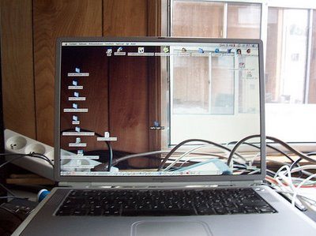


I n n o v a t i o n
http://jyoti.tandukar.net/innovation
4

Slide 2
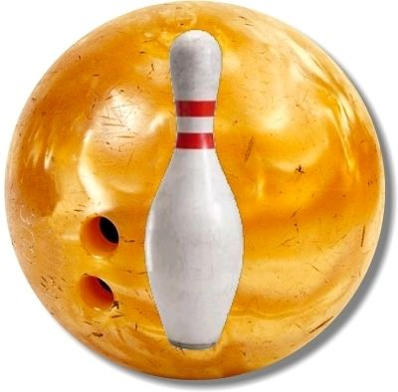
Bowling
Game
Computer
Electronics
Mechanical
The Ball
Circumference < 0.69 m
Weight < 7.26 kg
The Pin
Height = 38 cm
Width = 12 cm
1.53 kg < pin weight < 1.64 kg
Within a set of ten pins, the individual weights may vary by no more than 113.4 g (wood or plastic coated), or just 56.7 g (synthetic).

Slide 3
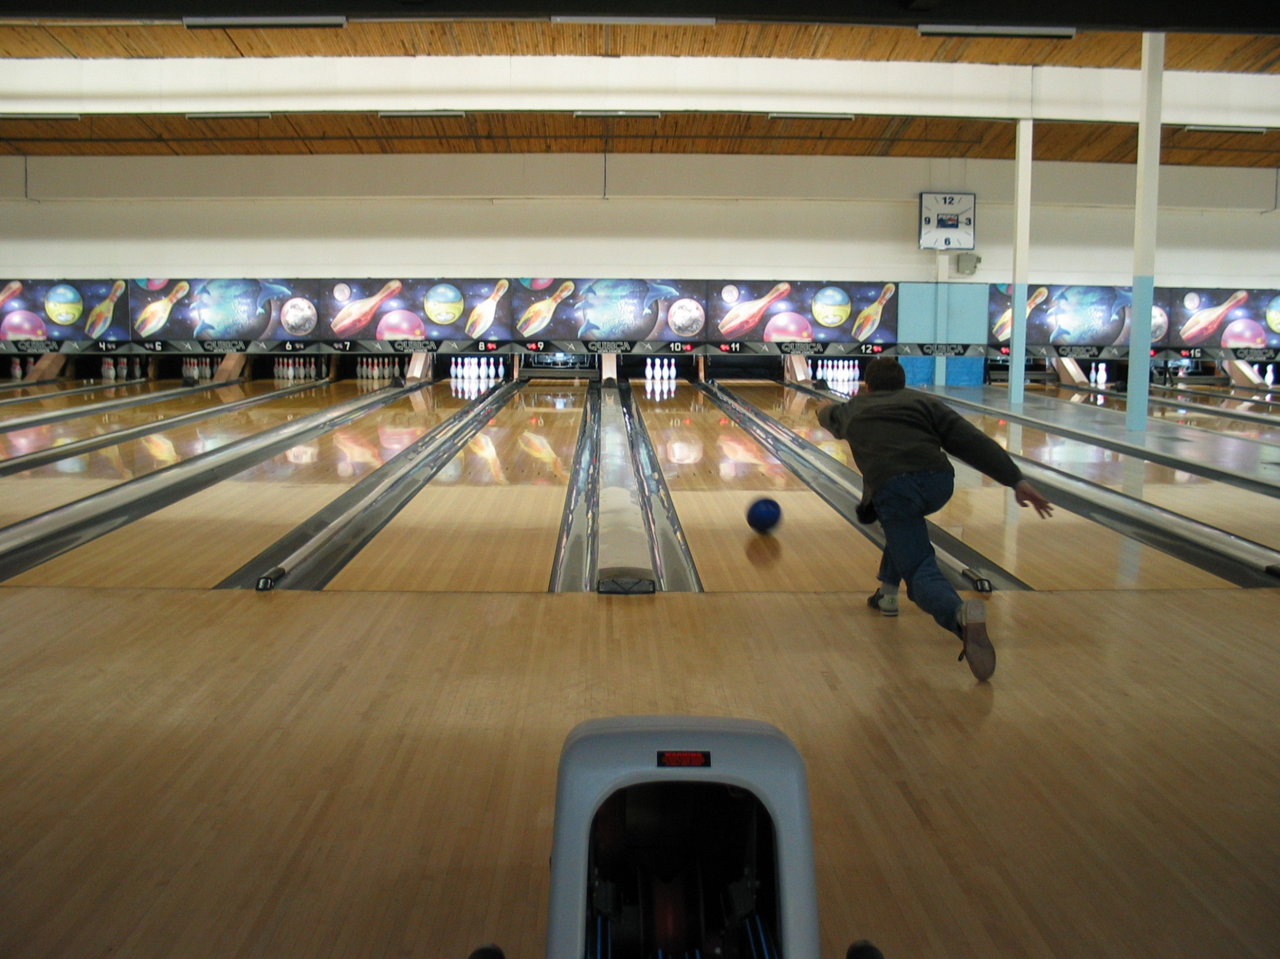
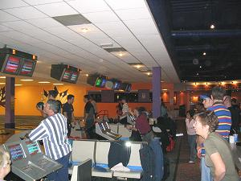
105 cm wide, 18 m lane
is bordered along
its length by "gutters”.

Slide 4
External Materials
See this bowling video.
Notice additional info in this video.
Play this bowling game.
Do a manual vs. automatic comparison in another context, clearly listing out advantages and disadvantages.

Slide 5
Your Part
Watch this presentation on “Notice”
Know these “Invention Facts”
Watch this video on Intelligent Electrical Outlet
Watch this video on Siftables
Watch this video on Wireless Electricity
Refine your idea and detail it according to Google Idea Contest format

