Slide 1

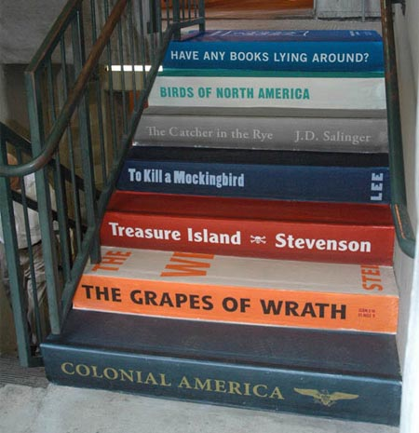
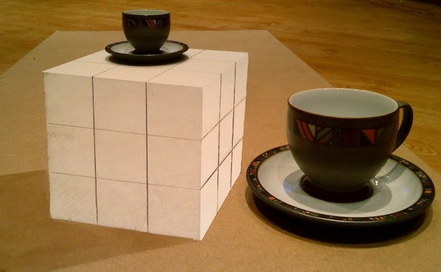
I n n o v a t i o n
http://jyoti.tandukar.net/innovation
5

Slide 2
New digit representation
Old seven segment vs. New four segment

Slide 3
4 segment assignment
1
2
3
4
5
6
7
8
9
Notes:
The participants are required to remember the symbols for the digits. 1-2 minutes.

Slide 4
Write these numbers
Notes:
What percentage could answer?

Slide 5
Analysis of the situation
Was this exercise difficult to the audience of this kind?
Was the time given to memorize the symbols insufficient? Will increase in time help in achieving better result?
Were the symbols too similar to memorize without confusion? Will use of different colors for different symbols help in achieving better result?
Or could there be simply a better way of presenting the content so as to achieve better result?

Slide 6
4 segment assignment revisited
1
2
3
4
5
6
7
8
9
Notes:
The same sequence can be remembered in 15 seconds.

Slide 7
Now write these numbers
Notes:
What percentage could answer?

Slide 8
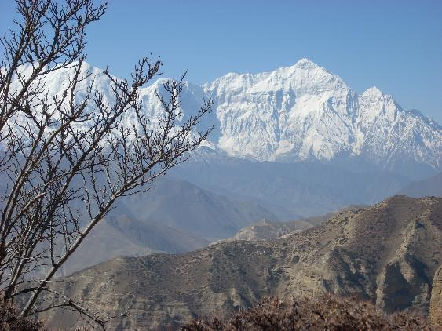
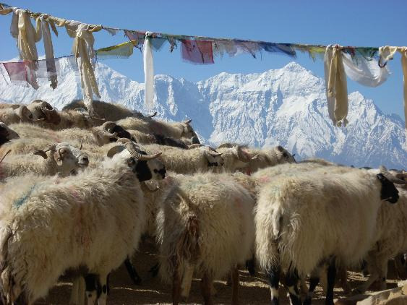
Text Vs. Visual
243087216513498733749130
243087216523498733749130
Notes:
Text is better for computer. Visual is better for human. We remember faces than names.

Slide 9
Concluding Messages
There are better ways of organizing our materials to make the lessons interesting, and easier to understand and remember.
As far as practicable, visual and graphical methods should be used in order to get better results. We remember very little of what we read compared to what we see.

Slide 10
Your Part
Read this comic, and think whether this could be a true story.
Watch this video on Hexacopter, and observe how things could be explained with limited text or voice.
Watch this video on IP to understand a complex phenomenon in simple way.
See this presentation and this video on 3D printer.

Slide 11
Team Assignment
Do your assigned reading:
The other kind of solar power
Sensors and Sensitivity
The Connected Car
Do some additional research on your topic
Prepare an effective presentation (20 min) summarizing your topic to present in class.

