Slide 1
Virtual Carpet Suite
CASE STUDY
computer graphics
innovation for
custom carpets
Jyoti Tandukar, Ph.D.
Chairman and CEO
A l t e r n a t i v e
T e c h n o l o g y

Slide 2
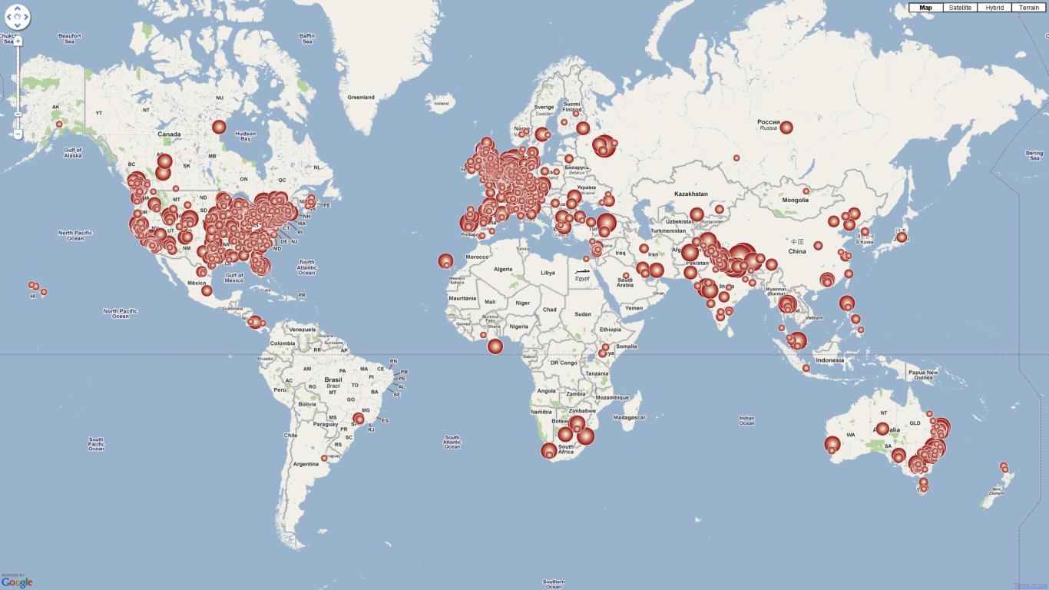
75+
Nepal
17+
UK
New York
11+
300
Towns of
the UK
47
States of
the USA
Accessed online from 1639 cities of 66 countries

Slide 3


Topmost companies dealing with custom rugs world-wide
Leading
rug producers
in Nepal

Slide 4

July, 2006
Winter, 2006
June, 2007
May, 2008
August, 2008
January, 2009
Carpet and Flooring Review
Modern Carpets and Textiles
idFX
Carpet and Rug
Carpet and Flooring Review
Carpet XL

Slide 5
an inspiration for Nepalese in IT
who are trying to do something at their own
The lessons learned
along the rough road
could prove be instrumental
in the growth and success
of other technology innovators in future
A l t e r n a t i v e
T e c h n o l o g y

Slide 6
Outline of this presentation
The Software Suite (about us)
The journey (amid difficulties, we reached here)
The lessons (what have we learned)
The resolution (what message we deliver)
A l t e r n a t i v e
T e c h n o l o g y

Slide 7
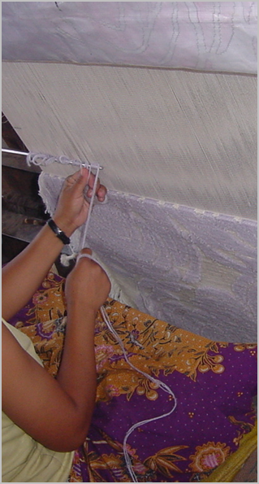
Carpet Industry at its Peak (mid 90’s)
About 2,000 Producers
Employed more than 200,000 people
Total Export more than 140 million dollar every year
Contributed 40 to 60% of Total Export
Notes:
If you have not seen a carpet being woven, here is a picture of the same.

Slide 8
Carpet Export Figures Source: TEPC, Nepal
Year | Germany |  | USA
 | m² | $ | m² | $
2061/62 | 827,213 | 33,671,199 | 357,358 | 24,835,950
2062/63 | 671,987 | 28,088,067 | 344,151 | 26,578,016
2063/64 | 613,286 | 27,344,690 | 337,003 | 28,958,768
2064/65 | 556,280 | 26,408,764 | 358,445 | 33,173,397
Total Export in 2063/64 = 1,341,757 m² = $79,375,420

Slide 9
Current Situation
With the total exports diminished by about one half compared to the golden era
Need to maximize sale and minimize production time and cost without compromising in quality
Must develop of compelling designs and diversify the product to avoid saturation
Adopting appropriate technology could bring in these remedies, boosting Nepalese market share of high-end custom rugs.

Slide 10
What
Why
How
Software
High Technology
For designing
For coloring
For illustrating
For communicating
For manufacturing
For selling
To convince clients
To improve production
To sell rugs faster
By visualizing end product
By integrating designing with manufacturing
By saving time, energy, raw materials

Slide 11
an extremely user-friendly software
can be instantly handled by designers with
prior graphics knowledge
www.galaincha.com.np
No prior
computer knowledge is required
owners can customize, illustrate and find production details with ease

Slide 12
To Convince Clients
You can quickly convert your concepts into presentable rug designs (from natural photographs, scanned images, hand sketches, etc.)
You can instantly evaluate the final design in different color combinations
You can see/show the end product with different weaving and finishing options before it is actually woven
Notes:
Galaincha has automatic color combination feature as well.

Slide 13



Notes:
Different materials (eg. Wool and silk), different finishing options (eg. Carved and not carved), different weave (high and low pile, cut and loop pile)

Slide 14
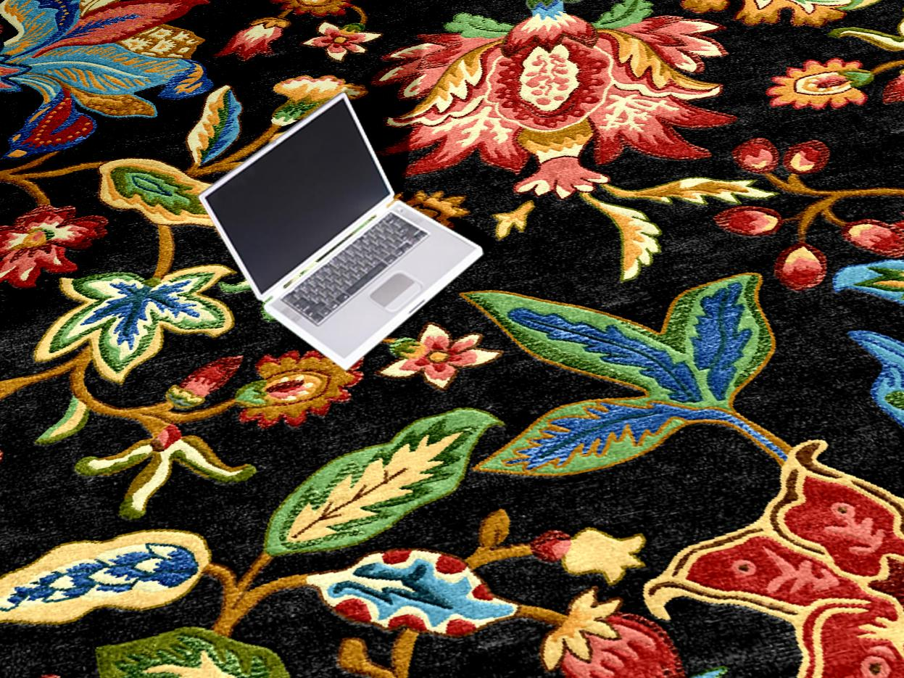
Notes:
Rug on floor

Slide 15

Notes:
Close up view (in exploRUG only). Strike off feature is coming in Galaincha in near future.

Slide 16
To Improve Production
You can print graph from the artwork directly, and weave exactly as illustrated
You can accurately estimate consumption of each color yarn, thus minimizing wastage
You can easily manage and retrieve all your design and graphs in digital form (compared to physical ones)
Notes:
exploRUG has automatic price calculator feature as well.

Slide 17
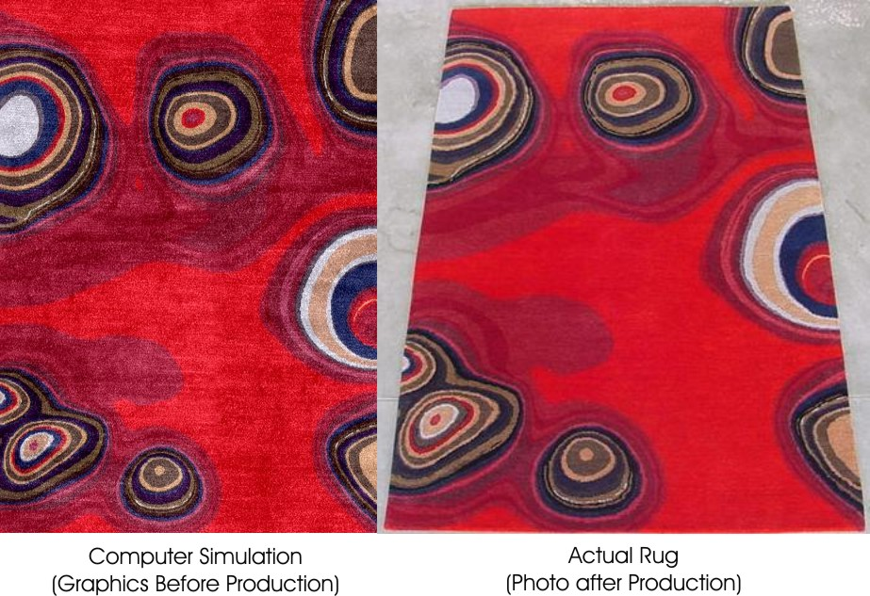
Design © Anne Reynolds
Notes:
As the simulation and graph is produced based on the same artwork, finished rug has knot by knot accuracy.

Slide 18
To Sell Rugs Faster
You can communicate these as small email attachments, saving a lot of time and money in express mails
You don’t have to wait for factory data to calculate silk percentage and know your cost or selling price
You can enhance customer confidence through “before and after” images of your past productions
Notes:
Galaincha has automatic color combination feature as well.

Slide 19
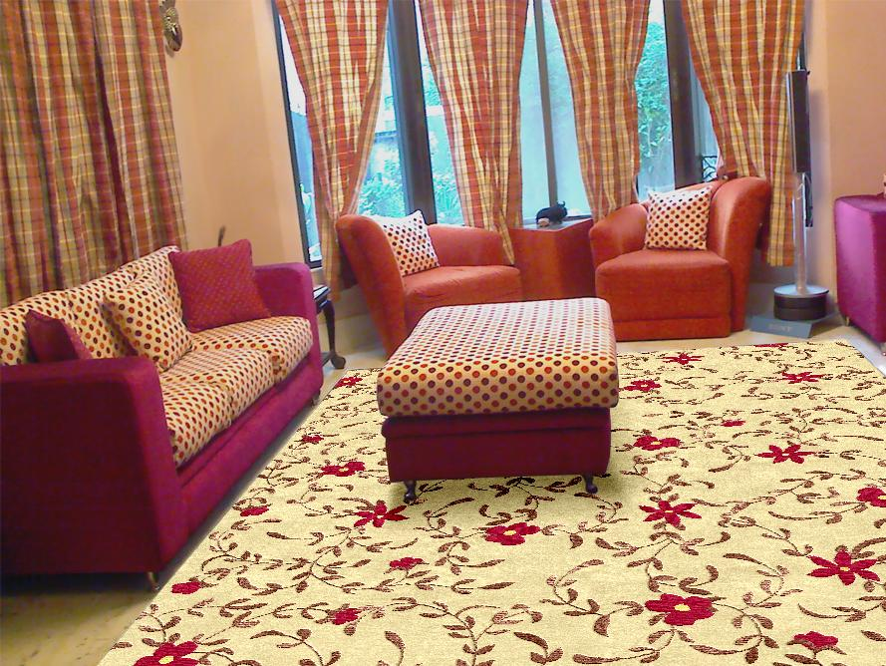
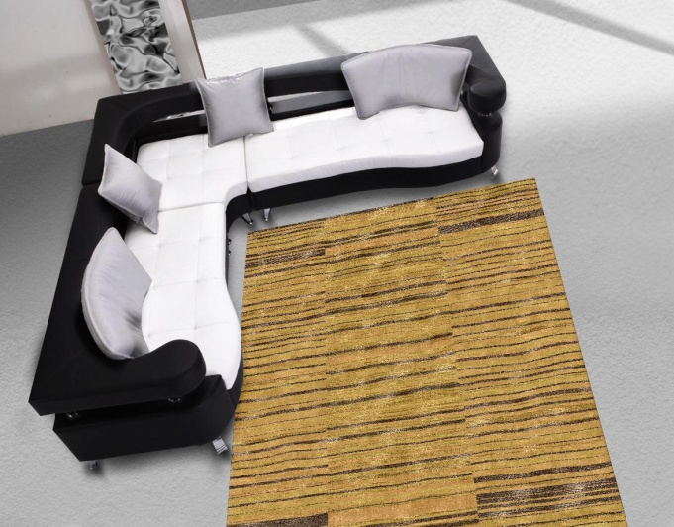
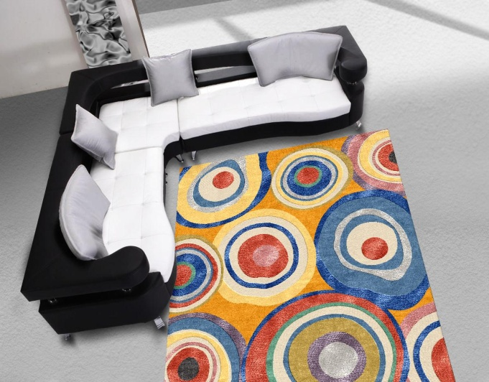
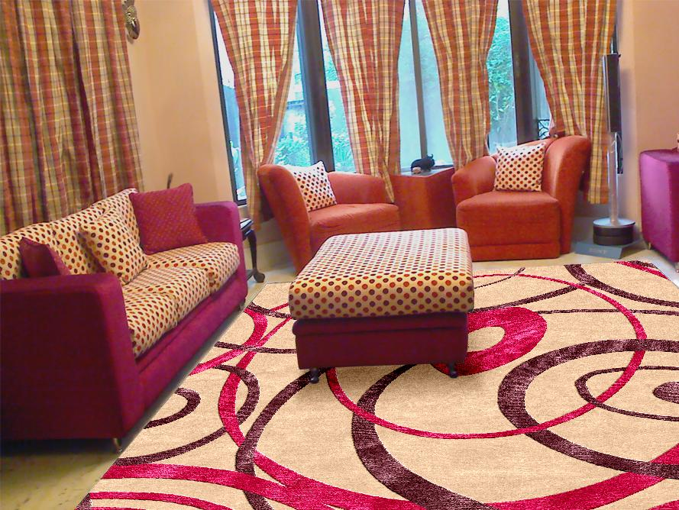
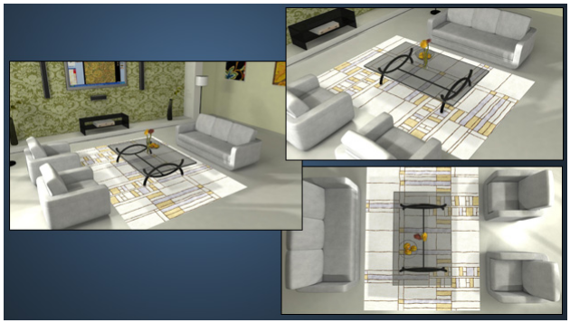

Slide 20
Virtual Carpet Technology
GREEN yet economic | saves time . saves raw materials . saves energy
A number of transforming advantages in carpet making, including efficiency, productivity, cost saving, and finding best combination of color, texture, material and finishing that were otherwise not possible manually
A computer visualization of the end product before the actual weaving begins
A l t e r n a t i v e
T e c h n o l o g y

Slide 21
Vertical Technology
Confined only to carpet industry
Not generalized
despite having potential
Textile
Interior
Fashion
Pashmina

Slide 22

One of the very few
global standards
for designing and
Illustrating rugs to clients,
and exchanging carpet data
between
the manufacturer
and the buyer.
Notes:
We largely depend upon imported high tech products, in that sense, VCS is an exemplary success story. Not owing to technical supremacy alone. Nor this ordinary and small Nepali software company did have sufficient budget to back a global ad campaign.

Slide 23
Internal
Engineered Procedure
Efficient
People
KNOWLEDGE COMPANY
No Capital
No Raw Material
Logical
Physical
Effective Process
Elevated Product
External

Slide 24
Journey over One Decade
1997. Started with a small requirement to convert digital artwork into weaving graph. technical difficulties: computer graphics was new difficulty in persuading the early clients
2000. Grown into full featured designing software. two technologies used in the software were also patented
2004. Started spreading world-wide on word of mouth. customers bringing in more customers
2007. Developed new product for marketing.

Slide 25
Computer as platform
Internet as platform
G R O W T H
1999
2007
2008
2010

Slide 26
The Rough Road
Nepal’s image as a backward country We need several world class technology products just to wash out this image
Internet cost/bandwidth sluggish connectivity that costs outrageously compared to other parts of the world, giving us a double blow We need better internet connectivity at affordable rates to facilitate business as well as other development activities
International fund transfer connectivity of our banks is so poor that we end up losing noteworthy amount on the way during bank transfers We need access to global financial services to conduct our business efficiently
Notes:
Obvious difficulties: domestic conditions, political instability, unnecessary regulatory issues, lack of action oriented policies.

Slide 27
Lessons Learned
ideal industry and appropriate timing. carpet manufacturers already had international contacts going through a troubled time of declining exports needed to improve their process in order to reverse the trend
user centric development / personalized approach. we have a policy not to disclose their list gained us word of mouth propagation world-wide
another peculiar policy: all updates free of cost. loss in “upgrade” revenue < the goodwill of our clients our users are our promoters = no ads needed a product made successful by the people who use it
continued learning and exploration. newer and transforming ideas ahead of time innovation
Notes:
Clients do feel much comfortable doing business with us because we maintained their confidentiality. May not be true for red ocean. The biggest: simplicity. Not a long list of features, but show how simple it is to achieve goals and solve problems through it.

Slide 28
Right first time
Error and correction
Needs a lot of
capital and resources
Make mistakes but quickly learn and correct
Identify inefficiencies and eliminate through new technology
Not a suitable model for small innovators
Redefine excellence through addition of valuable features
Anticipate future and prepare accordingly

Slide 29
Hard Science
Soft Skills
Demand Innovation
powerful but simple to use package
extra ordinary service
exactly what
customers need

Slide 30
High tech innovation and service
We can’t catch up
High technology and knowledge intensity
quickly and cheaply imitated
Entrepreneurship
and innovation

Slide 31

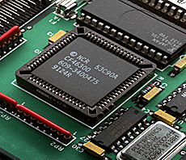

INPUT
OUTPUT
Key Resources
Replication
Value Added
Capital
Raw Material
Time
Cost
Object for cash
Object for cash
License for cash
No transit time or cost for global distribution
Sometimes this is dangerous

Slide 32
Our Resolution
For a small country like ours, the mantra doesn't lie only in hard work and luck, but also in innovation in a service oriented niche market where large companies cannot enter.
A l t e r n a t i v e
T e c h n o l o g y

Slide 33
