Slide 1


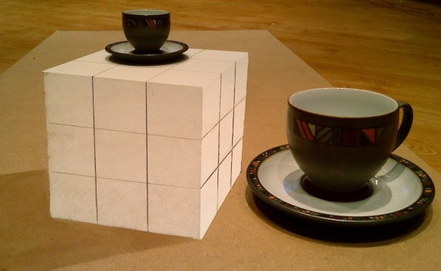
I n n o v a t i o n
http://jyoti.tandukar.net/innovation

Slide 2


TV
Audio Recorder
Web Browser
Video Player
GPS
Music Player
Clock
Calculator
Email Client
Gaming
Back up Storage
Camera
PDA
Phone
Torch
FM
Skype Phone
Wallet
Photo Album
Online Services
SMS/MMS
Document Viewer
Video Recorder
Level Meter
Notes:
This is the computer of future, with more processing power, storage, sensors, advanced software
and internet connectivity.

Slide 3
Listen to people around you for ideas.
Common problem requiring a solution may embed an opportunity for invention in it.
Any Product
Minor changes
Innovation
Think of derivatives of technology you are already using.

Slide 4
Innovation is not enough
Sometimes, product innovation alone is not sufficient for business success. We have seen many examples of the innovative product being quickly copied by industry giants, and making their copied product successful instead through their influence, capacity and market reach, eventually killing the original. Microsoft is notoriously known for this kind of strategy.

Slide 5
Too much of Foundation
Business and Industries
Feasible Business
Wealth Creation
Business Mind
Employment
OJT
MSc - II
MSc - I
BE - IV
BE - III
Desired State
BE - II
BE - I
Current State
Academic World

Slide 6
subject fundamentals
presentation
report writing
following instructions
punctuality
organizing
internet searching
dreaming
Career

Slide 7
logical analysis
lateral thinking
Commu-nication
decision making
adjusting
planning
Cooking
accounting
technology basics
Decorating
Cleaning
fixing utilities
Life

