Slide 1

PRESENTED BY:
Er. VIVEK RAJ SHRESTHA
Er. PRABHAT ADHIKARI
Er. DEVENDRA KATHAYAT
PRINVESTIGTOR
Dr JYOTI TANDUKAR

Slide 2
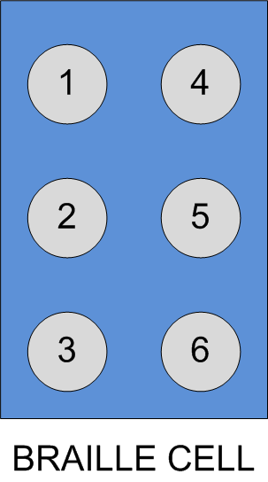
WHAT IS BRAILLE?
Script to read and write for the visually impaired people
Based on touch and feel
Fundamental element of the script: Braille Cell
Braille Cell: 3X2 matrix of dots
Braille Pattern: Raised dots

Slide 3
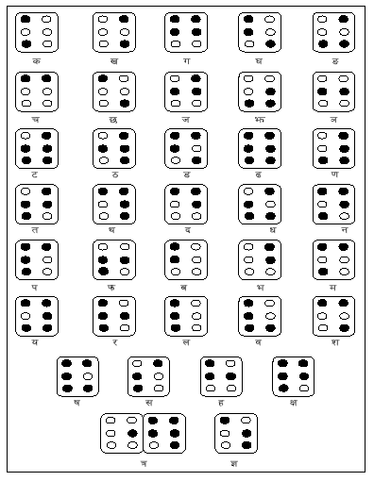
NEPALI BARNAMALA IN BRAILLE

Slide 4
WHY BRAILLE TUTOR?
Requirement of a dedicated human tutor with each student throughout the learning process
Difficulty in teaching with the traditional method
Development of a dedicated device as aid in learning provides the visually challenged people a sense of independence
Accuracy and efficiency in learning with the dedicated device called Braille Tutor

Slide 5
BRAILLE TUTOR
Braille Tutor-an extension of the Computer-aided Learning, especially targeted for the visually challenged
Trains Braille script in Nepali barnamala (devanagari script)
Braille Device developed to generate Braille pattern on a 3x2 matrix of six pins
Network of a number of Braille devices to be used in a classroom for teaching a corresponding number of visually challenged students
`

Slide 6
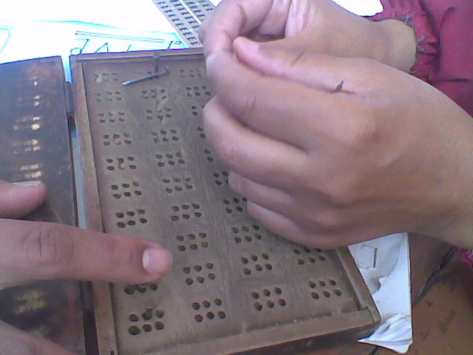
EXISTING METHOD
Human tutor
Slate and nails
Difficulties:
Low efficiency in learning process
Safety concern due to use of nails

Slide 7
WORKS DONE SO FAR….
Two field visits and case studies:
Section of Visually Impaired, Laboratory School, Kirtipur
Early Rehabilitation Centre, Lagankhel
Design and development of a Braille device capable of generating braille patterns for the alphabets given as speech input through the microphone or as mouse input in the GUI interface developed for the system
Developed system in first phase- in process of donation to a School for blinds in Nepal

Slide 8
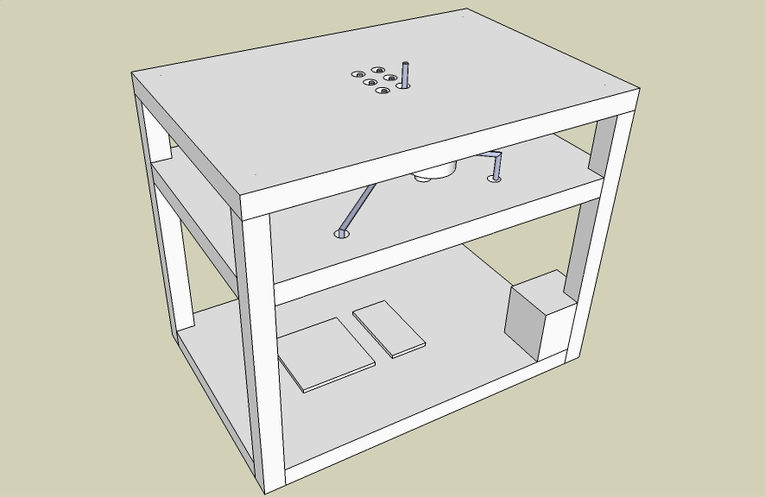
DESIGN OF THE BRAILLE DEVICE

Slide 9
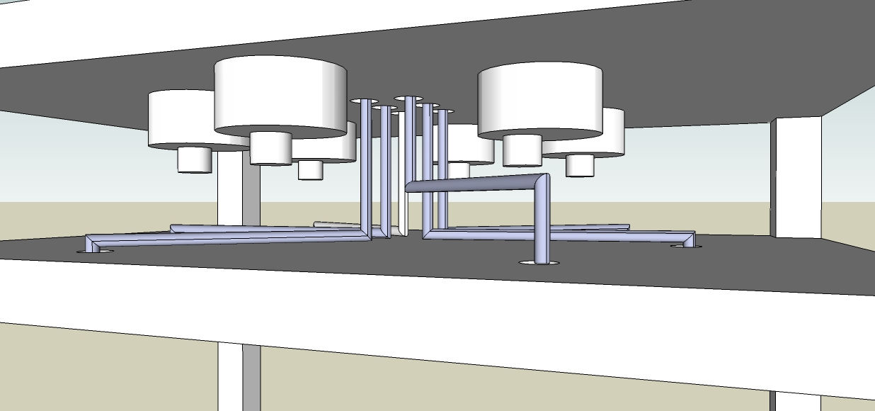
BRAILLE DEVICE (CNTD…)

Slide 10
RESEARCH CONCEPTS
Develop a network (Wireless/LAN) of Braille devices so that a corresponding number of visually challenged people can be taught braille by a single teacher/operator who operates at the master-control of the network
Use simple interface for operating at the master-control by implementing a simple keypad for input of alphabets and a LED matrix to display the alphabet pressed
Study the possibility of implementation of speech interface by enhancing the speech recognition implemented in the first phase of the project at master-control for convinient operation of the system
Find out possibilities to develop other assistive devices for the Visually challenged people

Slide 11
EXPECTED OUTCOMES
Development of a system which can be used as learning aid in classrooms for teaching Braille alphabets to a number of visually challenged people simultaneously
Develop a sense of independence among the visually challenged people with the use of a device rather than involvement of a human tutor
Interactive learning environment, Accuracy and efficiency in learning process of Braille
Distribution of the system to different schools of Nepal

Slide 12

SYSTEM BLOCK DIAGRAM
INPUT KEYPAD
MASTER CONTROL
Network (Wireless/LAN)
LED Matrix Display
Braille
Device
1
Braille
Device
2
Braille
Device
N

Slide 13

QUESTIONS…..

Slide 14

THANK YOU!!!

Slide 15
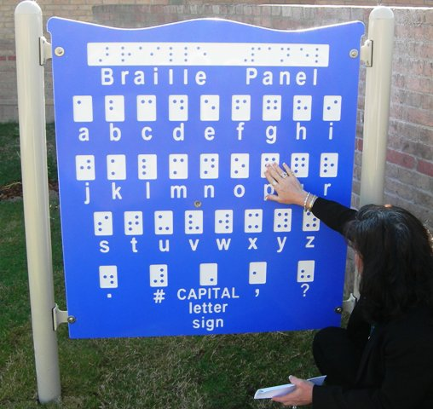
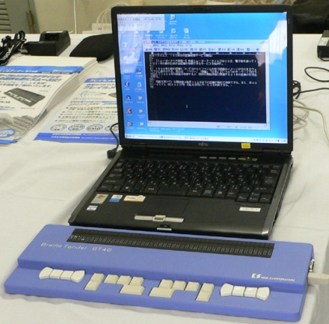
BRAILLE Tutor
in Local Language
VIVEK RAJ SHRESTHA | PRABHAT ADHIKARI | DEVENDRA KATHAYAT
DR JYOTI TANDUKAR | advisor

Slide 16

BRAILLE
The script to read and write
for the visually challenged
3x2 matrix of dots
Touch and feel the raised dots

Slide 17
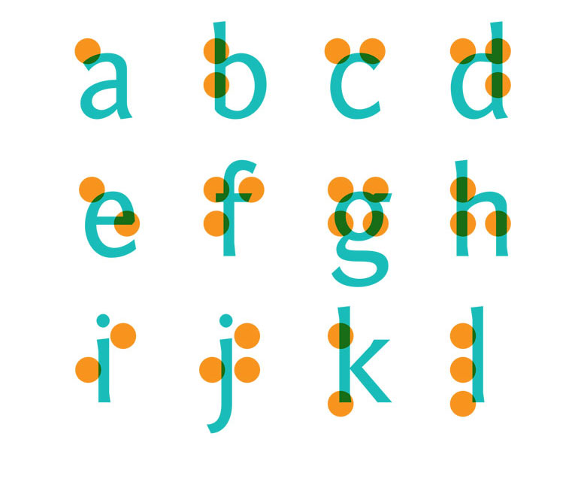
English Braille

Slide 18
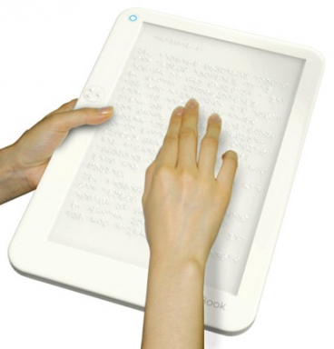
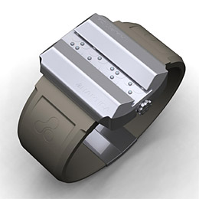
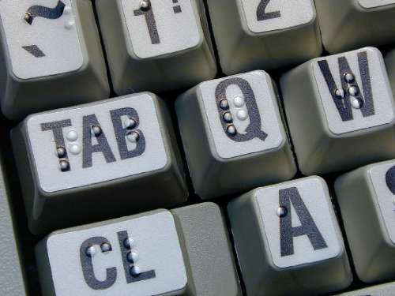
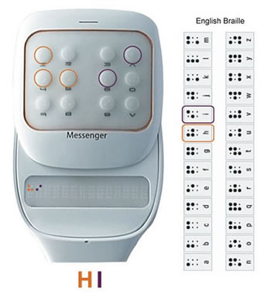
Keyboard with dots
Braille watch
Braille e-Reader
Technological Possibilities
Mobile messenger

Slide 19
NEPALI BRAILLE has got no technology enhancements yet

Slide 20
Training = 1 to 1 Tutor based method
Tutor
Nail
Less efficient
&
Unsafe
Pupil
Slate

Slide 21
Computer-aided learning along with
computer-controlled hardware
Trains Braille in Nepali that can be customized for any local language
The Braille Tutor
Network of a number of Braille devices for 1 to many teaching in a classroom environment

Slide 22
NEPALI BRAILLE Device
(computer controlled hardware)

Slide 23
Accomplishments
Two field visits and case studies:
Section of Visually Impaired, Laboratory School, Kirtipur
Early Rehabilitation Centre, Lagankhel
Design and development of a Braille device capable of generating braille patterns for the limited set of alphabets given as speech input through the microphone or as mouse input in the GUI interface developed for the system
Developed system in first phase - in process of donation to a School for blinds in Nepal

Slide 24
RESEARCH CONCEPTS
Develop a network (Wireless/LAN) of Braille devices so that a corresponding number of visually challenged people can be taught braille by a single teacher/operator who operates at the master-control of the network
Implement simple interface for operating at the master-control using a keypad for input of alphabets and a LED matrix to display the alphabet pressed
Study the possibility of speech interface at master-control by enhancing the speech recognition implemented in the first phase of the project
Investigate other possibilities of assistive devices for the Visually challenged people

Slide 25
SYSTEM BLOCK DIAGRAM
INPUT KEYPAD
MASTER CONTROL
Network (Wireless/LAN)
LED Matrix Display
Braille
Device
1
Braille
Device
2
Braille
Device
N

Slide 26
EXPECTED OUTCOMES
Efficient one to many teaching of braille in technology assisted classroom environment
Possibility of independent self-learning for visually challenged people through an interactive system
Distribution of the system to different schools of Nepal through various organizations working for the blind

Slide 27
QUESTIONS…..
Thank You

Slide 28

Choose
Craft
Connect
Consult
Communicate
Capture
Cope
Change

Slide 29
WHAT IS BRAILLE?
Script to read and write for the visually impaired people
Based on touch and feel
Fundamental element of the script: Braille Cell
Braille Cell: 3X2 matrix of dots
Braille Pattern: Raised dots

Slide 30
BRAILLE
The script to read and write
for the visually challenged
3x2 matrix of dots
Touch and feel the raised dots

Slide 31
EXISTING METHOD
Human tutor
Slate and nails
Difficulties:
Low efficiency in learning process
Safety concern due to use of nails

Slide 32
Training = 1 to 1 Tutor based method
Tutor
Nail
Less efficient
&
Unsafe
Pupil
Slate

Slide 33
BRAILLE TUTOR
Braille Tutor-an extension of the Computer-aided Learning, especially targeted for the visually challenged
Trains Braille script in Nepali barnamala (devanagari script)
Braille Device developed to generate Braille pattern on a 3x2 matrix of six pins
Network of a number of Braille devices to be used in a classroom for teaching a corresponding number of visually challenged students
`

Slide 34
Computer-aided learning along with
computer-controlled hardware
Trains Braille in Nepali that can be customized for any local language
The Braille Tutor
Network of a number of Braille devices for 1 to many teaching in a classroom environment

Slide 35
EXPECTED OUTCOMES
Development of a system which can be used as learning aid in classrooms for teaching Braille alphabets to a number of visually challenged people simultaneously
Develop a sense of independence among the visually challenged people with the use of a device rather than involvement of a human tutor
Interactive learning environment, Accuracy and efficiency in learning process of Braille
Distribution of the system to different schools of Nepal

Slide 36
EXPECTED OUTCOMES
Efficient one to many teaching of braille in technology assisted classroom environment
Possibility of independent self-learning for visually challenged people through an interactive system
Distribution of the system to different schools of Nepal through various organizations working for the blind

Slide 37
Keyboard with dots
Braille watch
Braille e-Reader
Technological Possibilities
Mobile messenger

